Slide 1

GLOBALMART_SALES_DATA PROJECT
BY: SHALOM WANJIRU WAINAINA

Slide 2
SCOPE
STUDY QUESTIONS
CRISP-DM Methodology
VISUALIZATIONS
RECOMMENDATIONS
CONCLUSION

Slide 3

STUDY QUESTIONS
Which regions and product categories are under performing in terms of sales and profit?
What product category contribute the most to profitability, and which are dragging it down per region?
Is the company’s sales growth sustainable compared to previous years?
How can the insights driven help in optimizing resource allocation and decision making?

Slide 4
CRISP-DM Framework in the GlobalMart Sales Performance
The CRISP-DM methodology provides a structured, repeatable approach to solving business problems using data. It consists of six phases, which guide the entire data analysis journey:
Business Understanding
Data Understanding
Data Preparation
Modeling
Evaluation
Deployment
GlobalMart_Sales_Data Performance Analysis capstone project. In this project, I applied the CRISP-DM methodology, a structured process for data mining and analytics, to evaluate sales and profit performance per region, state and category.
The goal is to generate actionable insights that help GlobalMart grow and remain competitive in the market.

Slide 5

BUSINESS UNDERSTANDING & OBJECTIVES
GlobalMart is a multinational retail company operating across diverse product categories such as Furniture, Office Supplies, and Technology. Despite having a wide market reach and growing sales volume, the company faces inconsistent profitability across regions and products categories. The goals of this analysis it to;
Identify key drivers of sales and profit performance across different regions and product categories.
Uncover sales trends over time to evaluate growth sustainability.
Detect underperforming areas where declining profit margins or slow sales growth may hinder company objectives.
Provide actionable insights that will support GlobalMart’s goal of making data-driven decisions to optimize sales performance and profitability.
The analysis will empower stakeholders to make strategic business decisions regarding resource allocation, regional strategies, and product focus, ultimately driving growth and improving profitability.

Slide 6
DATA UNDERSTANDING
In the data understanding phase, the GlobalMart sales dataset was carefully examined to assess its quality and suitability for analysis. The process involved:
Data Cleaning: Removed blank rows and corrected errors to ensure data consistency.
Standardization: Reformatted the Region column to proper case for uniformity.
Outlier Treatment: Analyzed extreme values in the Sales column. One sale of 500,000 was retained for calculation checks, while other unrealistic outliers were removed by filtering.
Filtering & Validation: Ensured that only valid and relevant records were included for analysis.
This steps established a reliable and accurate dataset, forming the foundation for building trustworthy insights and visualizations.

Slide 7
DATA PREPARATION
Data Cleaning & Structuring; Removed duplicates, standardized formats, and validated column values. Reformatted categorical fields (Region, Category) for consistency.
Feature Engineering; Created calculated columns:
Unit Price = Sales ÷ Quantity
Profit = Sales – Cost (derived using business rules)
Profit Margin % = Profit ÷ Sales
Month & Year columns extracted from the Date field
Time Intelligence Support; Built a Date Table to enable calculations like YTD, PY, and YoY Growth
Measure Creation (DAX);
Total Sales, Total Profit, Order Total
Sales Growth %, Profit Margin %, YoY growth
Cumulative Sales and Profit trends
The dataset was fully prepared to support both descriptive and time-based analysis.

Slide 8
MODELLING
In this phase of the CRISPDM Methodology, I did KPI development, Trend and Comparative Modeling and segmentation & contribution analysis.
KPI Development; Designed core performance measures: Sales, Profit, Profit Margin, YoY Growth. Enabled drill-downs by Category, Region, and Customer
Trend & Comparative Modeling; Time-series analysis: Sales & Profit YTD, PY, and cumulative performance. Comparative dashboards: Sales vs Profit, Sales Growth % vs Profit Margin %.
Segmentation & Contribution Analysis; Analyzed contribution of Regions, States, and Product Categories. Highlighted top-performing and underperforming segments

Slide 9
EVALUATION
The Evaluation phase ensures that the models and insights created truly address the business problem and meet GlobalMart’s business objectives. It is not just about checking accuracy but also about validating business relevance.
Review whether the created models. For example, Total Sales, Profit Margin %, YoY Growth – do they perform well and answer the business questions.
Verified that insights are understandable, actionable, and aligned with GlobalMart’s goals. For example, Regional performance dashboards should reveal which regions are profitable and where improvements are needed.

Slide 10
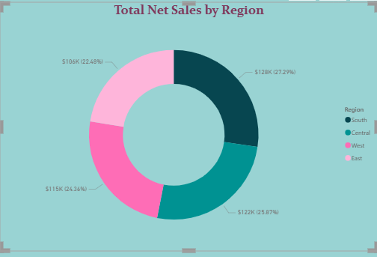
TOTAL NET SALES PER REGION
DEPLOYMENT
Balanced Distribution: Sales are more evenly distributed across all four regions, with South $128K-27.29%, Central $122K-25.87%, West $115K-24.36%, and East $106K-22.48% contributing fairly similar shares.
Opportunities Across All Regions: Each region now appears to contribute significantly, meaning that growth strategies can be applied more broadly instead of focusing only on one.
GlobalMart has a strong and fairly even regional presence, suggesting resilience and room for optimization in all regions rather than corrective action in just one.

Slide 11
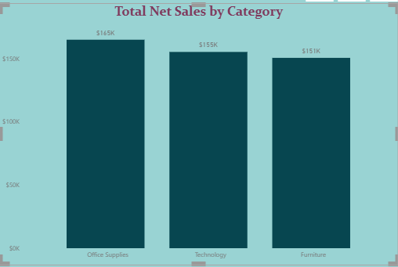
TOTAL NET SALES BY REGION
Office supplies generate the highest revenue at $165K, making them the strongest-performing category.
Technology follows closely with $155K, contributing significantly to overall sales performance.
Furniture records $151K, only slightly behind Technology, indicating consistent demand across categories.
The sales distribution is fairly balanced, with all three categories contributing between $150K and $165K. This suggests diversified product performance, reducing the risk of relying on a single category.
GlobalMart has a well-rounded product portfolio, with each category making a meaningful contribution. This balance provides flexibility in strategic planning and opportunities for targeted growth in all categories.

Slide 12
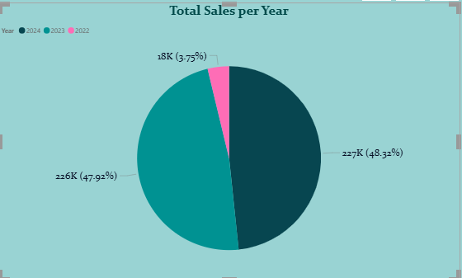
TOTAL SALES PER YEAR
In the Years 2023and 2024 GlobalMart recorded strongest sales, contributing almost equally to overall sales: 2024: $227K (48.32%) 2023: $226K (47.92%). Cummulatively, they account for over 96% of total sales.
2022 however, shows a significant decline, with only $18K (3.75%), which may suggest incomplete data for the year or an actual drop in sales performance.
The overall, sales performance has been relatively stable between 2023 and 2024, but the sharp dip in 2022 is a key concern that needs further analysis (possible reasons: reporting cut-off, market slowdown, or data limitations).

Slide 13
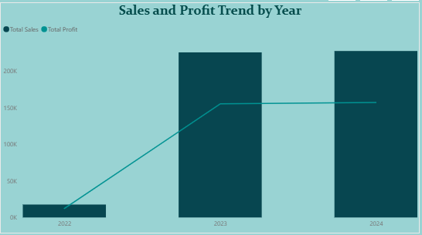
SALES & PROFIT BY YEAR
Profit follows a similar trajectory with sales, rising sharply from 2022 to 2023, aligning with the sales growth.
From 2023 to 2024, profit remains flat, showing no further improvement despite steady sales

Slide 14
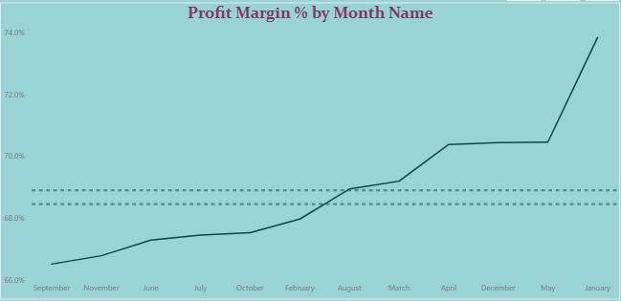
Profit Margin by Month
GlobalMart shows a clear, consistent increase in profit margin percentage from September through January. The line generally slopes upward, indicating that the company's profitability, per dollar of sales, has been improving steadily.
There's a notable steep increase in profit margin in the last few months shown on the chart (April to January). The final data point in January represents the highest profit margin, at nearly 74%. This suggests that recent strategies or seasonal factors have been highly effective in boosting profitability.
From September to around February, the profit margin grew at a slower, more gradual pace. The incline is less steep compared to the later months, which shows a period of moderate, continuous improvement before the accelerated growth.

Slide 15
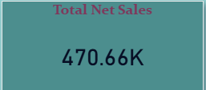


KPIs
The Total Net Sales for GlobalMart, after cleaning the data amounts to approximately $480K
The Total Quantity of products sold in the regions are 5K
Sales YoY Growth % of GlobalMart from the year 2022 to 2024 amounts to 0.94%

Slide 16

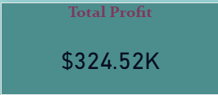
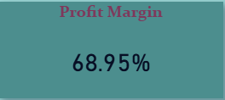

The profit PY (2022-2024) approximates to $168K.
Total Profit =SUM(GlobalMart_Sales_Data[Profit] contributed to approximately $325K.
Profit Margin = Total Profit & Total Sales which contributed to 68.95% of GlobalMart sales performance.
It takes approximately 5 days for GlobalMart products to be distributed.

Slide 17
INSIGHTS & RECOMMENDATIONS
Diversify revenue streams – Strengthen Furniture and Technology sales through targeted marketing and bundled promotions.
Leverage Office Supplies’ dominance – Expand upsell/cross-sell strategies by pairing Office Supplies with Furniture or Technology.
Investigate low Technology sales – Identify customer needs, product gaps, or pricing issues holding back growth.
Monitor category trends over time – Track year-over-year growth to ensure balanced performance across all categories.
Allocate resources and inventory toward top-performing regions and develop tailored strategies for underperforming regions
Expand product lines in categories with consistent growth trends.
Reassess product categories with low sales/profit contribution and consider discontinuing or repositioning them

Slide 18
RECOMMENDATIONS Contd.
While sales have held steady after the 2023 spike, profit margins may have stagnated, signaling possible increases in costs, competitive pricing, or inefficiencies in operations.
Diversify revenue streams – Strengthen Furniture and Technology sales through targeted marketing and bundled promotions.Leverage Office Supplies’ dominance – Expand upsell/cross-sell strategies by pairing Office Supplies with Furniture or Technology.
Investigate low Technology sales – Identify customer needs, product gaps, or pricing issues holding back growth.
Monitor category trends over time – Track year-over-year growth to ensure balanced performance across all categories.
GlobalMart grew strongly in 2023 but needs to focus on profitability in 2024 to sustain long-term performance.

Slide 19


CONCLUSION
GlobalMart’s sales data reveals strong growth potential, but achieving long-term profitability will require focusing on high-margin categories, addressing regional disparities, and leveraging customer insights to drive sustainable performance.

Slide 20


